Slide 1
A BASIC PROGRAM IN PYTHON

Slide 2
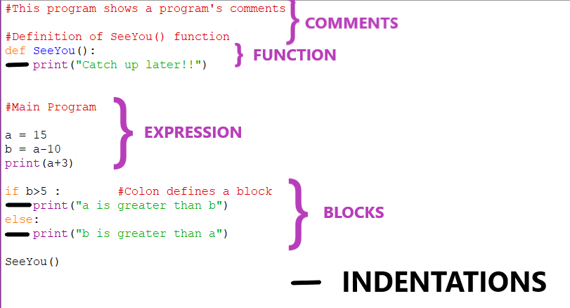
BAREBONES OF A PYTHON PROGRAM
STATEMENTS AND

Slide 3
BAREBONES OF A PYTHON PROGRAM
The main components of a Python program are:
Statements and Expressions
Comments
Blocks
Indentations
Functions

Slide 4
Statements and Expressions
A statement is a programming instruction that does something, i.e. some action takes place.
An expression is any legal combination of symbols that represent a value.
An expression represents something which Python evaluates and which then produces value.
EXAMPLE:
15 (only value)
2.9 (only value)
a+5 (produce a value when evaluated)
(3+5)/9 (produce a value when evaluated)

Slide 5
Comments
Comments are the additional readable information to clarify the source code comments in Python begin with the symbol #.
There are two types of comments:
1. Single line comments – start with a hash symbol (#)
2. Multiline comments – every line can have a hash symbol (#)
Comments enclosed in triple quotes (“””) or triple apostrophe (‘’’) are called docstrings.

Slide 6
Blocks and Indentations
A group of statements which are part of another statement or function are called block or code-block or suite in Python.
Python uses indentation to create blocks of code.
Statements at the same indentation level are part of same block or suite.
Statements requiring suite or code block have a colon (:) at their end.
You cannot unnecessarily indent a statement that is Python will raise error for that.

Slide 7
Functions
A function is a code that has a name and it can be reused(executed again) by specifying its name in the program anywhere.
SYNTAX:
def <func-name> (<arguments-list>) :
#Statements
EXAMPLE:
def SeeYou():
print("Catch up later!!")

Slide 8
VARIABLES AND ASSIGNMENTS

Slide 9
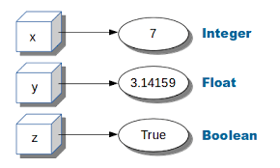
Variables
Named labels whose values can be used and processed during program run are called variables.
Python variables are created by assigning value of desired type to them.
Python will internally create labels referring to these values as shown:

Slide 10
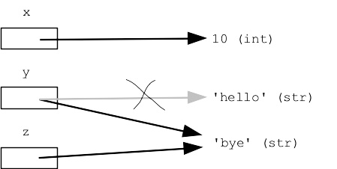
Variables (Contd.)
Variables are not storage containers in Python.
Variables in Python do not have fixed locations unlike other programming languages.
The location they refer to changes every time that value changes.

Slide 11
DYNAMIC TYPING IN PYTHON
A variable pointing to a value of a certain type can be made to point to a value object of different type.
This can be done by re assigning a value of datatype. Python will not raise any error.
This is called dynamic typing feature of python.

Slide 12
MEMORY ALLOCATION IN PYTHON
Python variables do not need explicit declaration to reserve memory space.
The declaration happens automatically when you assign a value to a variable.
The equal to sign (=) is used to assign values to variables.
EXAMPLE :
counter = 100 # An integer assignment
miles = 1000.0 # A floating point
name = "John" # A string

Slide 13
ASSIGNMENT IN PYTHON
Python allows you to assign a single value to several variables simultaneously
>>> a = b = c = 1
Here, an integer object is created with the value 1 and all the three variables are assigned to the same memory location.
You can also assign multiple objects to multiple variables.
>>> a, b, c = 1, 2, "john“
Here, two integer objects with values 1 and 2 are assigned to the variables a and b respectively, and one string object with the value "john" is assigned to the variable c.

Slide 14
STANDARD DATA TYPES
The data stored in memory can be of many types.
For example, a person's age is stored as a numeric value and his or her address is stored as string characters.
Python has various standard data types that are used to define the operations possible on them and the storage method for each of them.
Python has five standard data types-
Numbers
String
List
Tuple
Dictionary

Slide 15
Happy Learning!

